Slide 1
Pacamor Kubar’s top accomplishments
The height of excellence
A concise look into some of
Past & Present
Aerospace and Defense edition

Slide 2
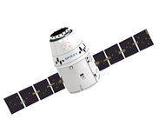
Aerospace & space flight
Pacamor has an extensive reach, assisting some of the worlds largest aerospace OEM’s.

Slide 3
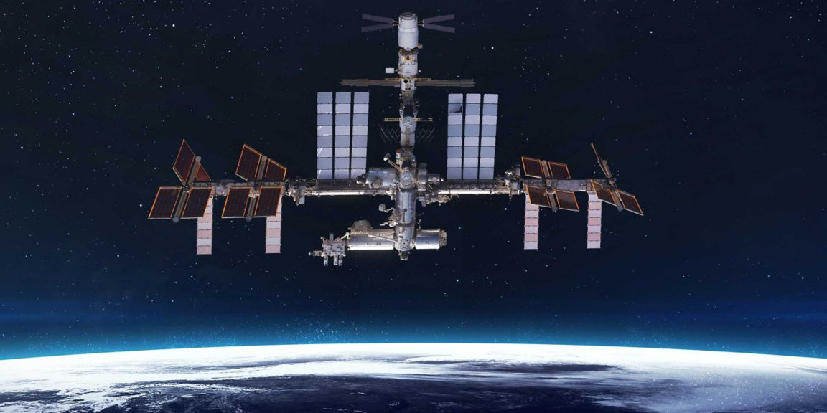
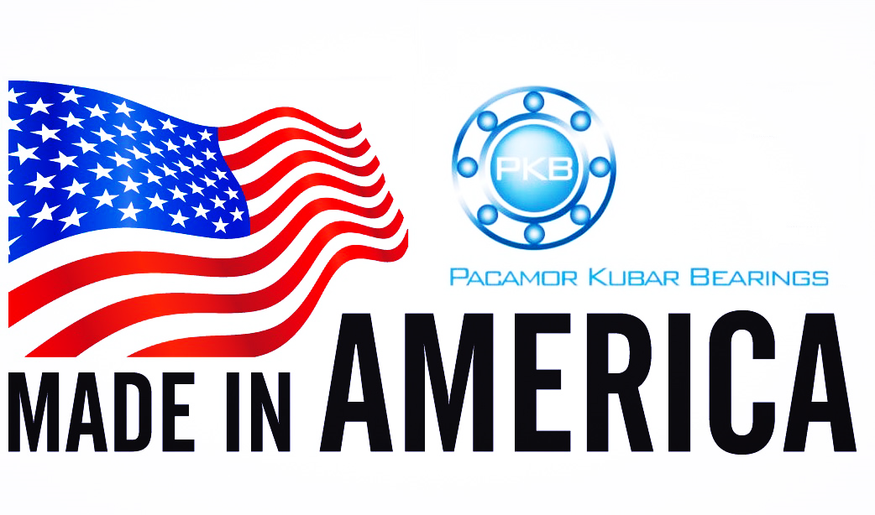
Docking station
Pacamor Kubar Bearings has supplied NASA and Honeywell with docking station bearings used throughout the International Space Station.

Slide 4
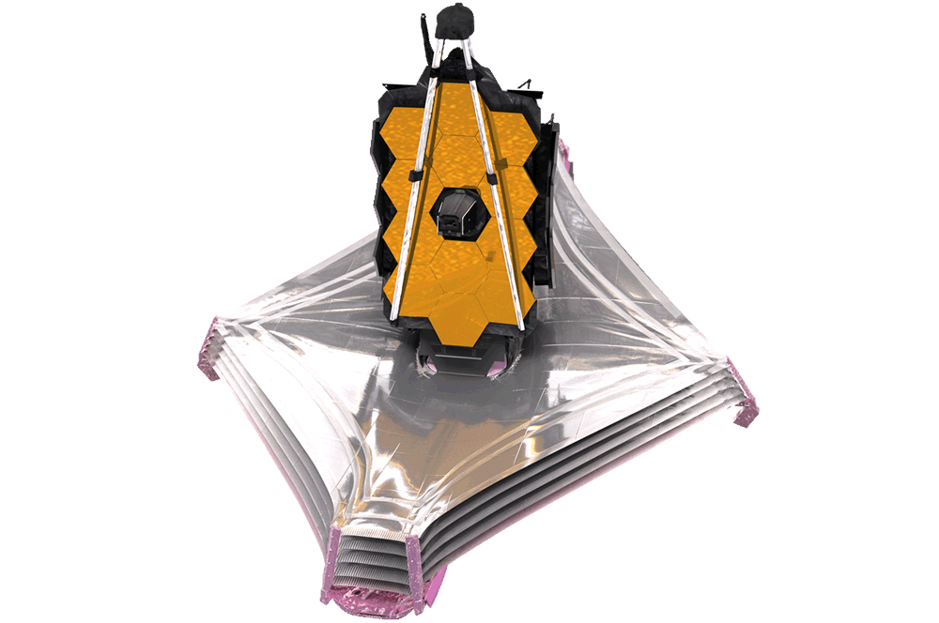
James webb telescope
PKB’s bearings are utilized in the JWST’s complex sun shield system.

Slide 5
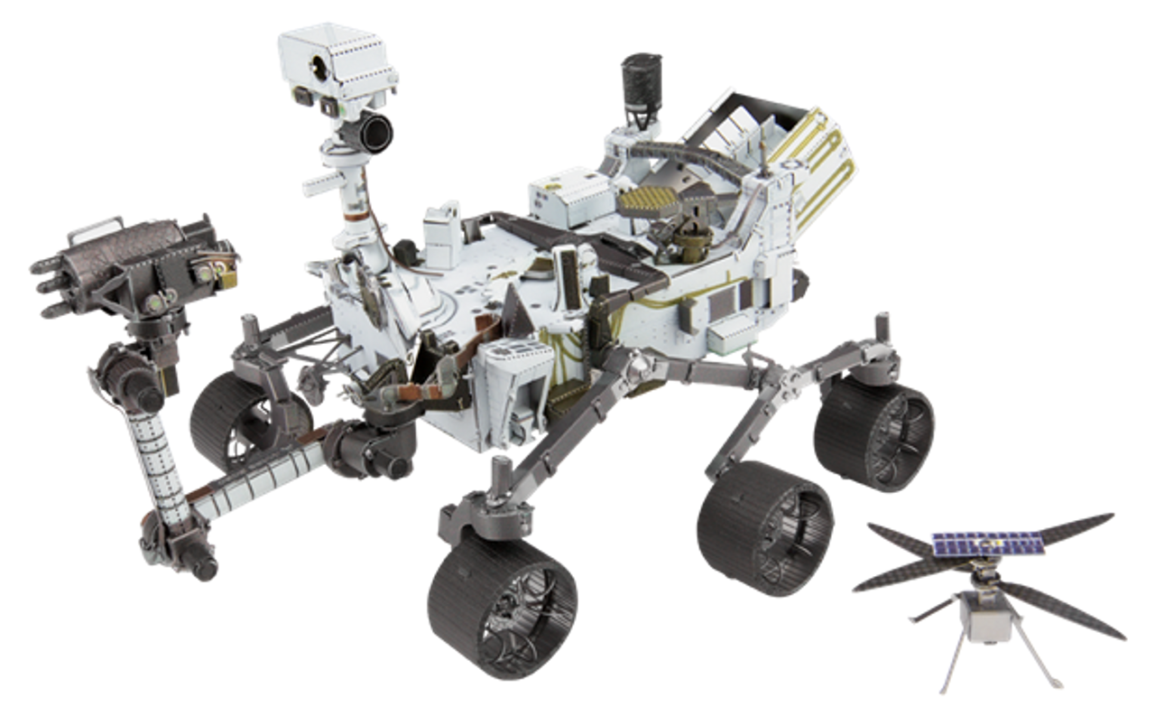
Mars2020 rover
Nasa procured our bearings to be used in the perseverance rovers’ robotic arm and cache system.

Slide 6
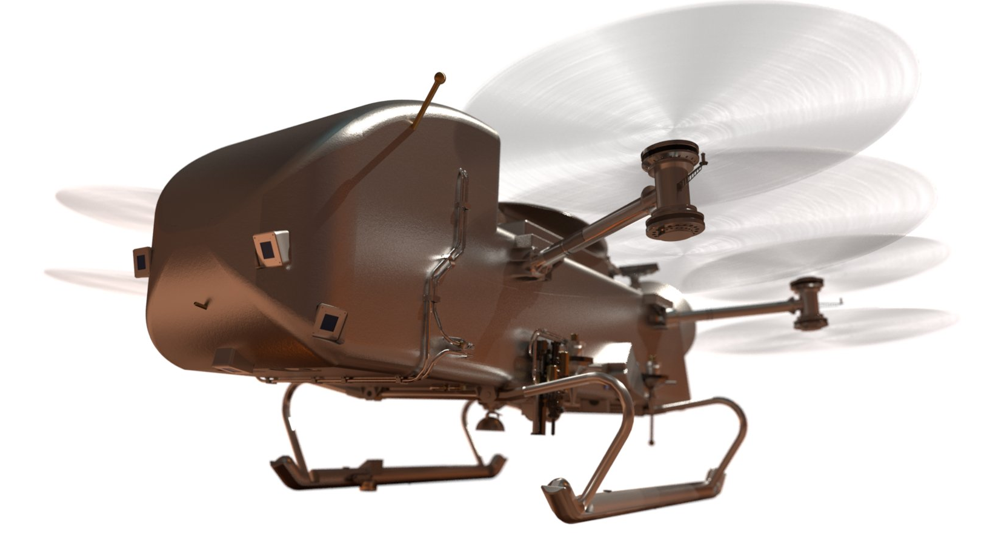
NASA DRAGONFLY
The Dragonfly’s rotocraft bearings will be made by PKB.
This spacecraft will touchdown on Saturns’ Moon, Titan.
Mission launch scheduled for 2026.

Slide 7
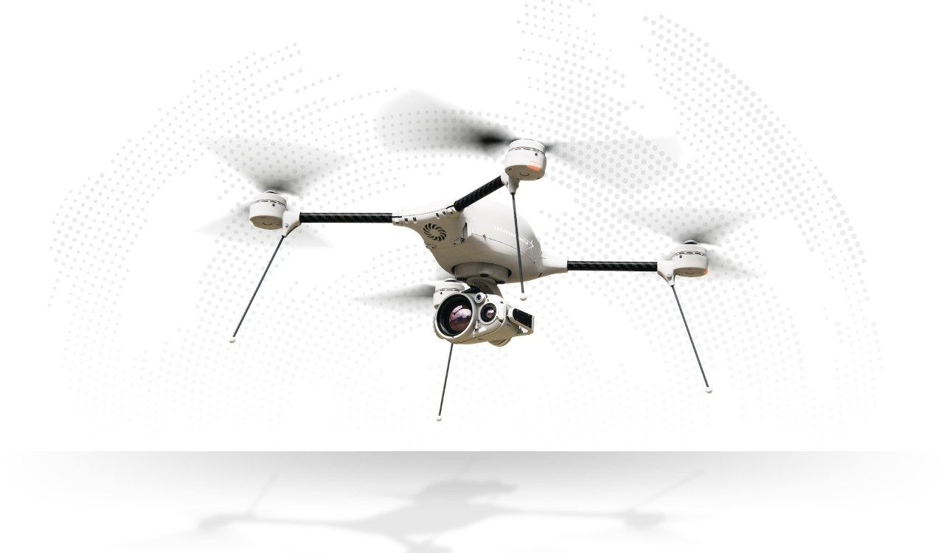
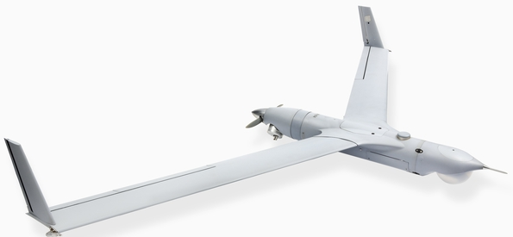
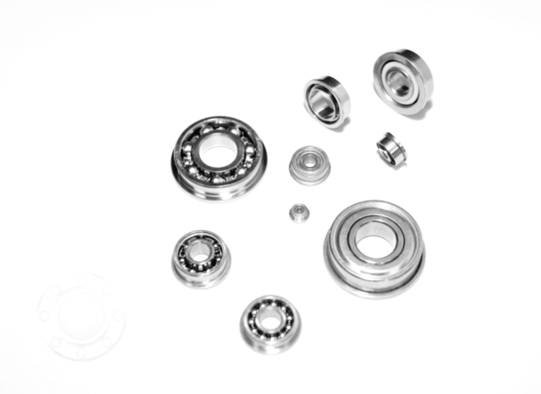
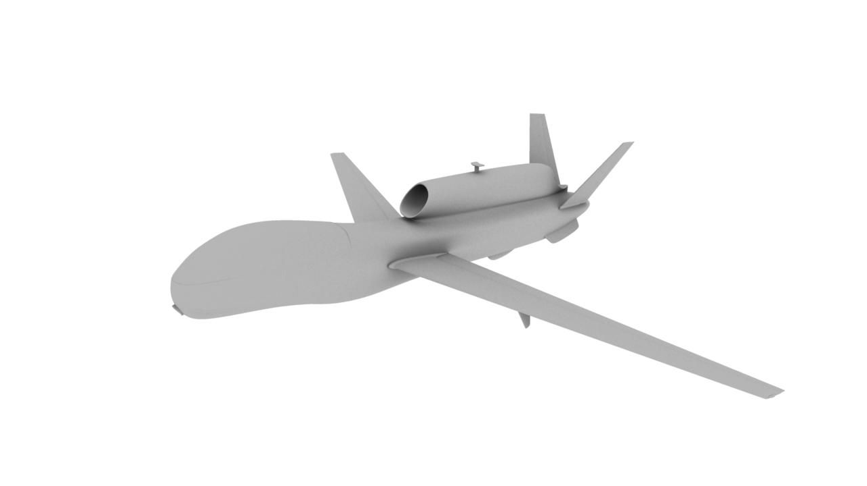
LOW-ORBIT AND UNMANNED SYSTEMS
Pacamor supplies companies with bearings for Low Earth Orbit (LEO) systems, particularly for reaction wheels.

Slide 8
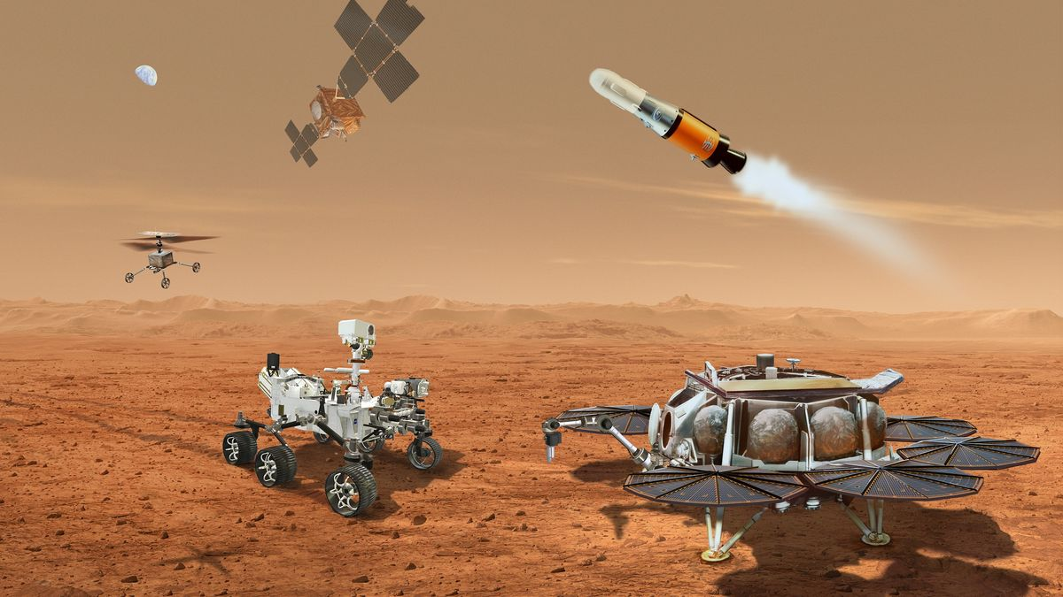
MARS SAMPLE RETURN
Mars Sample Return (MSR) Mission
This mission will involve the Mars2020 Perseverance rover, assisting in collecting soil and rock samples, then bringing them back to earth.
Our bearings will be used in the soil retrieval system.

Slide 9
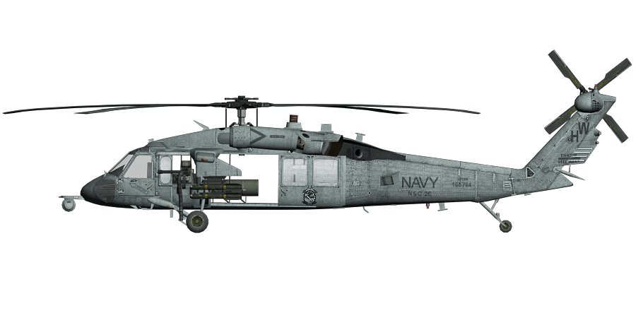
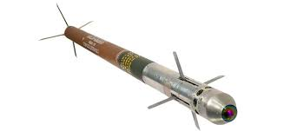
DEFENSE
Pacamor has been supplying the US Department of Defense and their allies for decades.
PKB bearings are used in guided missiles, aircraft avionics and weapons systems.

Slide 10
MORTER FUZES
PKB bearings are an essential part of M734 Morter fuzes, used by the US Army and its allies.

Slide 11
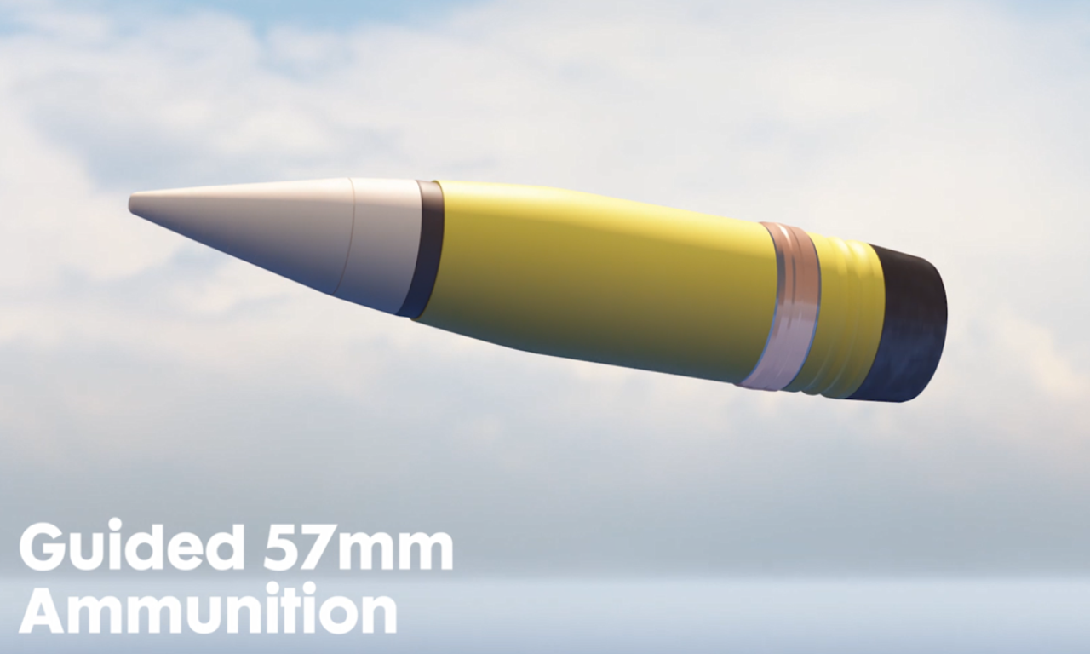
57mm guided bullets
Northrop Grumman’s 57mm guided ammunition are high-explosive shells designed to defend against fast-moving threats like drones and surface ships.
The ammunition is used by the US Navy, and has Pacamor Kubar’s bearings inside, to assist in the internal trajectory system.

Slide 12
Top supplier
Pacamor Kubar Bearings(PKB) is an industry leader in the manufacturing & development of precision and miniature ball bearings. We supply bearings for nearly every industry, including aerospace/space and defense, aviation, medical, and industrial.
PKB is proud to be a veteran-owned company that manufactures each bearing in-house, with zero foreign outsourcing. We conform to industry leading manufacturing processes and quality control. All of our bearings are DFARS-compliant, and we take pride in being a leading OEM supplier.
S/N Precision Enterprises Inc., dba Pacamor Kubar Bearings
Cage Code 14927

